Slide 1


Comparative Assessment of Dynamical and Statistical Downscaling Techniques with Bias Correction for Monsoon Rainfall over India
M.Sc. Dissertation Project
Sarang Soorej
M.Sc. Meteorology, CUSAT
Under the Guidance of:
Dr. Kondapalli Niranjan Kumar Scientist, NCMRWF

Slide 2
00
Project Goal
01
Introduction
02
Table of Contents
03
Dynamic Downscaling verification
Statistical Bias Corrections
04
Future Scopes
05
References
Notes:
What we are gonna do…

Slide 3
00
Project Goal
To evaluate and compare the performance of dynamical and downscaling techniques for monsoon rainfall forecasting over India, incorporating bias correction methods (EQM, PQM, GPQM) and with the aim of improving the accuracy and reliability of precipitation predictions

Slide 4
Introduction
01
Downscaling ? Dynamic?? Statistical???

Slide 5
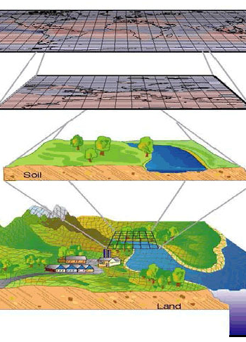
Down-scaling
Decreasing the pixel size of remotely sensed images
How this goal was achieved:
Statistical
Dynamical
Notes:
Down Scaling : extraction of high-resolution information from low-resolution variables
Dynamic : high-resolution regional climate model is nested into a GCM over the domain of interest. E.g.: WRF
Statistical : learn empirical links between the large and local-scale climate that are in turn applied to low-resolution climate model output (cheap in terms of computations)

Slide 6
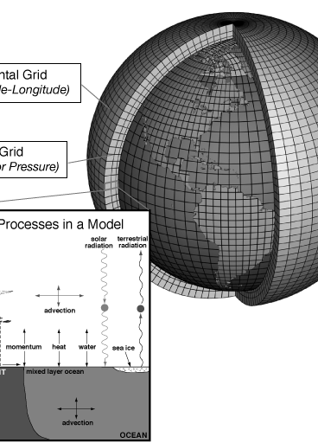
Dynamic Downscaling
Use numerical weather model to provide high-resolution climate factors by simulating the physical processes of the coupled land-atmosphere system
Notes:
A high-resolution grid is nested on the coordinates required for the high-resolution global model to infer high-resolution data
processing power high

Slide 7
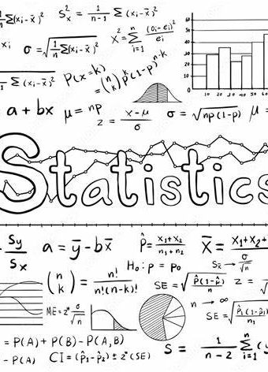
Statistical Downscaling
Developing an empirical relationship between local high-resolution and low-resolution data, either through linear regression or analog techniques
-> more accurate as the quality and quantity of these data increase
Notes:
Relationship or empirical formula is derived from comparing the local model data to observed and high-resolution data using mathematical or statistical equations

Slide 8
What we did ?
Evaluate the accuracy of the NCUM operational forecast
How different statistical Bias corrections improves the NCUM forecasts
Notes:
CNNs are efficient at leveraging the high-resolution signal from heterogeneous observational datasets,(predictors /auxiliary variables)
while downscaling low-resolution climatological fields

Slide 9
NCUM-G
NCUM-G a global numerical weather prediction model operated by Partnerships' Unified Model (UM)
12km domain model
Run all year round
Global
Horizontal and vertical extent
Horizontal grid resolution 12 km
70 vertical levels (top - 80 km)
Evaluate the accuracy of the NCUM operational forecast
How different statistical Bias corrections improves the NCUM forecasts

Slide 10
NCUM-R
NCUM-R is a high-resolution domain for the Indian region and is configured with the UM seamless prediction for various applications
The 4km domain model
Run all year round
62⁰E-106 ⁰E; 6 ⁰S 41 ⁰N
Horizontal and vertical extent
1200x1200 horizontally
90 hybrid levels vertically (top at 40km)

Slide 11
Datasets used
Dataset | Resolution | Temporal Coverage | Variable Used
NCUM-G | ~12 km | Multiple forecast lead times (Day 1, 3, 5) | Daily precipitation
NCUM-R | ~4 km | Multiple forecast lead times (Day 1, 2, 3) | Daily precipitation
IMD-MSG | ~10 km | Observed rainfall data | Daily precipitation
Evaluate the accuracy of the NCUM operational forecast
How different statistical Bias corrections improves the NCUM forecasts
Time period : JJAS 2020 - 2024
Notes:
effectiveness of the dynamical downscaling -> Global climate models (GCMs) and parameterisation schemes used

Slide 12
02
Verification of Dynamic Downscaling
Mean ? Variance ?? Bias??

Slide 13
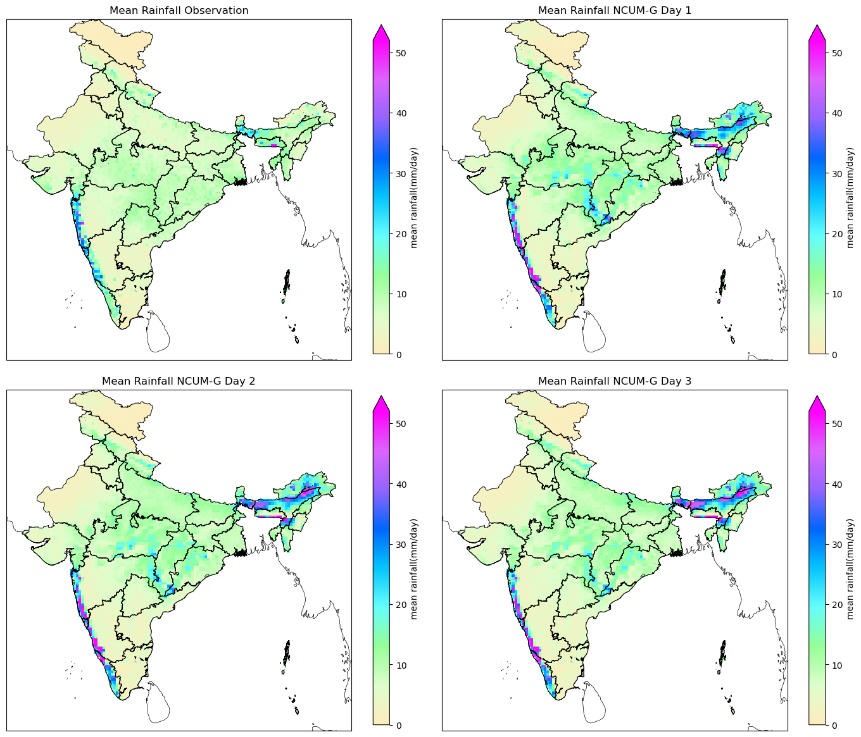
Mean Rainfall
NCUM-G
OBSERVATION : Higher rainfall along the Western Ghats, Northeast India, and some parts of the east coast.
DAY 1 : The model captures the broad rainfall patterns well but appears slightly over-estimates intense rainfall regions near the western ghats and North East. Little noise is present in the central parts of India
Day 2 : The rainfall structure weakens, maintaining similar overestimations along the coast and NE, more diffused spread of rainfall than Day 1 in Madya Pradesh and northern parts.
Day 3 : Reduction in rainfall intensity. Overestimates in Northeast India, although lower. Coastal rainfall remains somewhat high compared to observations
Capture rainfall patterns but struggles with localized accuracy
Errors in intensity and spatial accuracy increase in Coastal, Hilly and high-rainfall regions
Notes:
$${\overline{P}}_{\left(i,j\right)}=\frac{1}{T}\sum_{t=1}^{T}{P_{\left(ⅈ,j,t\right)}}$$
$P_{\left(ⅈ,j,t\right)}$Is the rainfall at grid point (i,j) at time t, and T is the total number of time steps

Slide 14
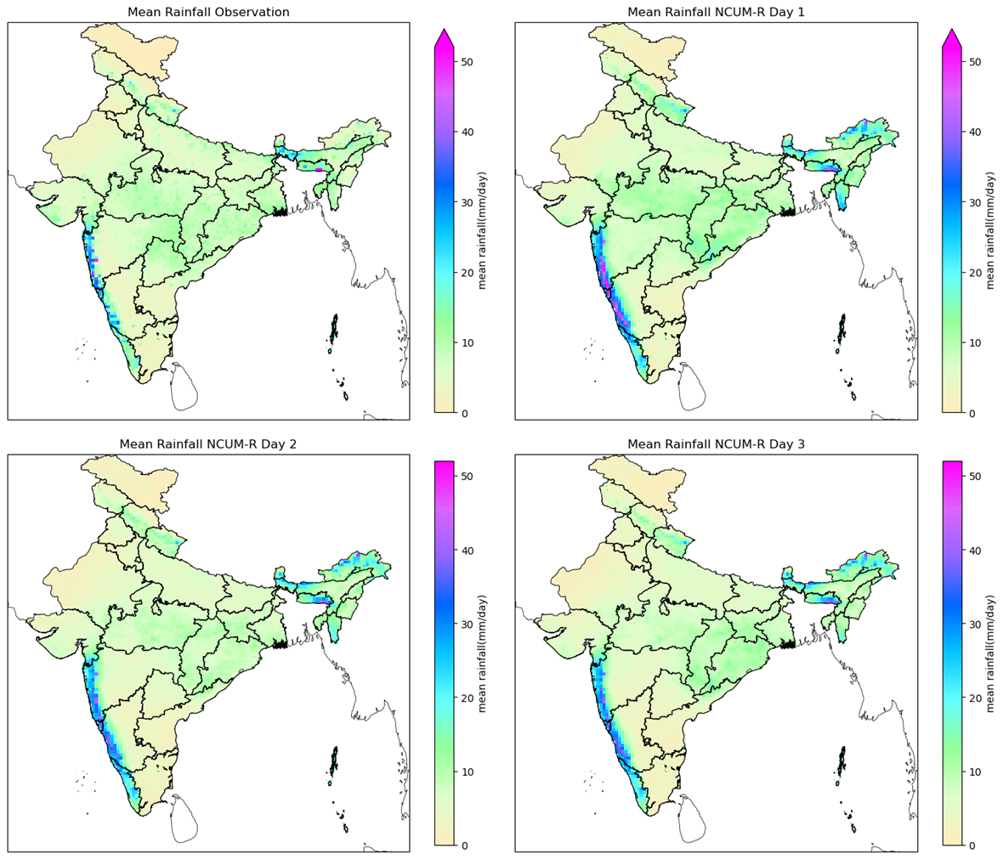
Mean Rainfall
NCUM-R
OBSERVATION : Higher rainfall along the Western Ghats, Northeast India, and some parts of the east coast.
DAY 1 : Similar broad features as NCUM-G but with smoother rainfall distribution, with slightly lower in intensities, low overestimation
Day 2 : Weakened further, but the pattern remains similar. Rainfall along the Western Ghats and coastal regions is present but more diffused. Better agreement with observed than NCUM-G.
Day 3 : Reduction in rainfall intensity. Overestimates in Northeast India. More spatially consistent
Captures large-scale rainfall features well.
Smoother and more balanced rainfall distribution than NCUM-G.
Less overestimation of coastal and Northeast India rainfall.
Might be slightly underestimating rainfall compared to NCUM-G, leading to potential dry biases.
Notes:
$${\overline{P}}_{\left(i,j\right)}=\frac{1}{T}\sum_{t=1}^{T}{P_{\left(ⅈ,j,t\right)}}$$
$P_{\left(ⅈ,j,t\right)}$Is the rainfall at grid point (i,j) at time t, and T is the total number of time steps

Slide 15
NCUM-G
Spatial Bias of Rainfall
NCUM-R
Consistent Overestimation -Western Ghats, northeastern India, and the Himalayan foothills.
Consistent Underestimation - Along opposite side of the same hills, (due to missed orographic effects)
Biases reduce slightly over time(model stabilisation), less overall compared to NCUM-G.
Consistent Overestimation -Western Ghats, northeastern India, and the Himalayan foothills.
Consistent Underestimation - Central India, parts of the eastern coast.
Biases reduce slightly over time, but spatial patterns remain similar Struggle with Orography
Notes:
Bias(i,j) = F(i,j) − O(i,j)

Slide 16
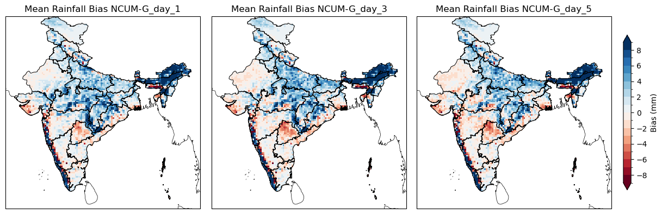

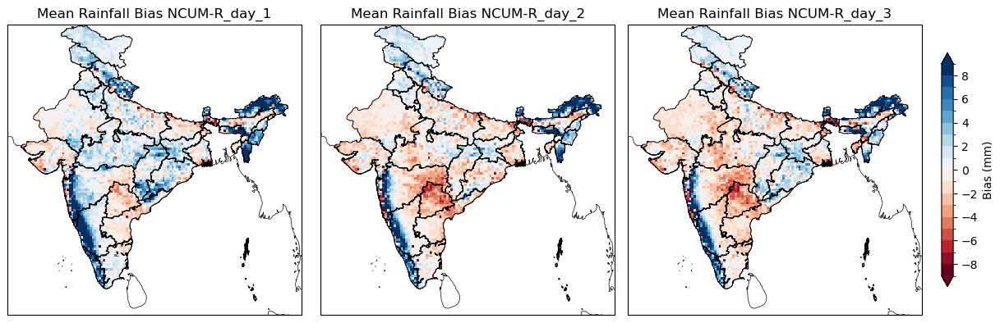
NCUM-G
NCUM-R
Notes:
Bias(i,j) = F(i,j) − O(i,j)

Slide 17
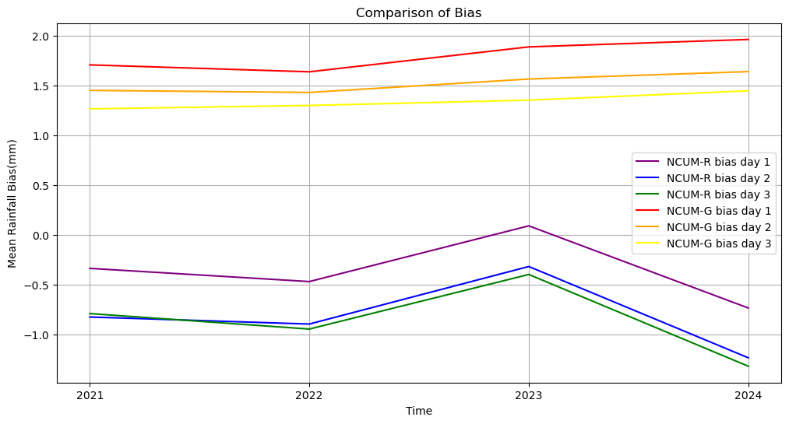
Time Series of Rainfall Bias
Notes:
Bias(i,j) = F(i,j) − O(i,j)

Slide 18
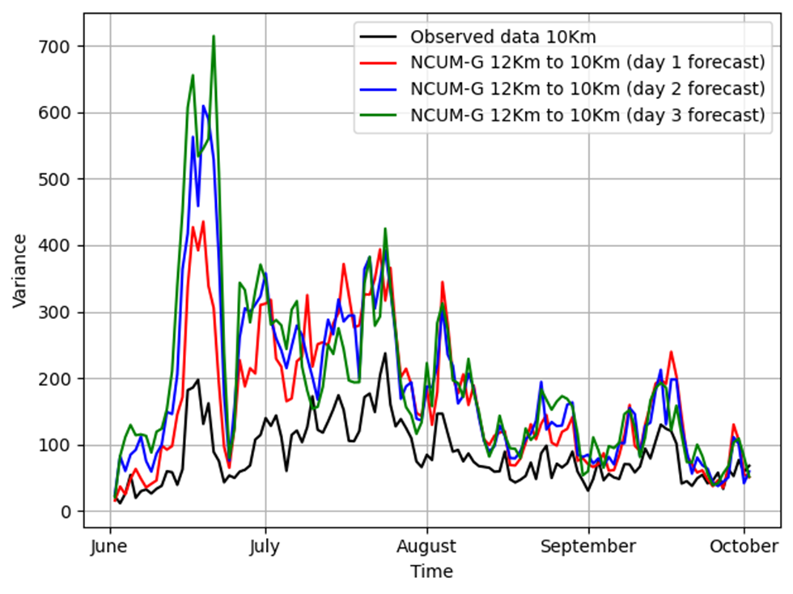
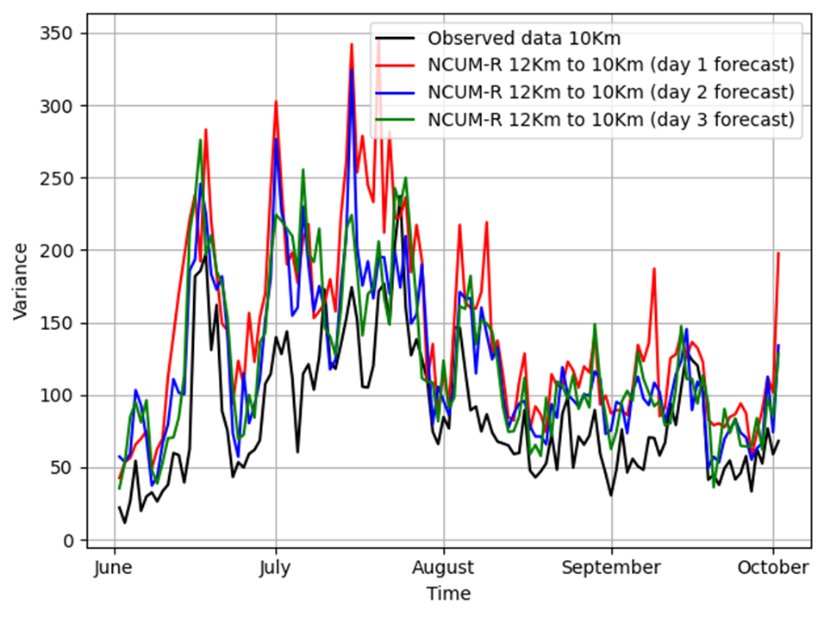
Variance - Rainfall
NCUM-G
NCUM-R
Notes:
σ²$=1/N \sum_{i=1}^{n}{ {\left(x_{i}−\overline{x}\right)}^{2}}$
Where:
$x_{i}$ represents individual forecast or observed values,
$\overline{x}$ Is the mean of the dataset,
N is the total number of data points.

Slide 19
Variance - Rainfall
NCUM-R
NCUM-G
Forecasts tend to overestimate variance, but closer to observed variance than NCUM-G.
Forecast follow a similar pattern to the observations.
Less erratic in its forecasts compared to NCUM-G.
Forecast skill varies with increasing lead time.
Consistently overestimating variance -> statistical downscaling or bias correction methods will help
Day 1 – really needs Bias correction as it shows most erratic features
Forecasts tend to overestimate variance, particularly in high-variance periods.
Forecast follow a similar pattern to the observations.
Forecast skill drops with increasing lead time
Consistently overestimating variance -> statistical downscaling or bias correction methods will help
Notes:
σ²$=1/N \sum_{i=1}^{n}{ {\left(x_{i}−\overline{x}\right)}^{2}}$
Where:
$x_{i}$ represents individual forecast or observed values,
$\overline{x}$ Is the mean of the dataset,
N is the total number of data points.

Slide 20
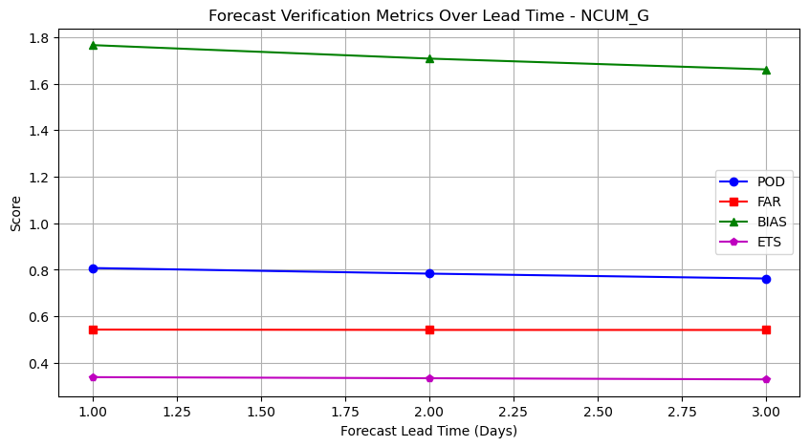
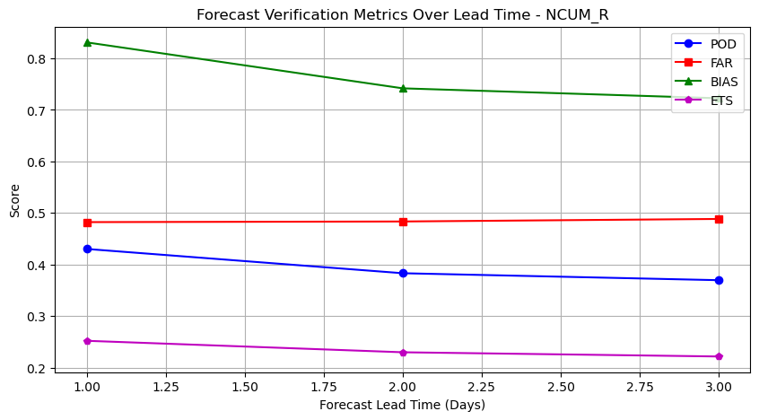
Forecast verification – Time series
NCUM-G
NCUM-R
Notes:
POD (Probability of Detection) - high for NCUM-R
ETS (Equitable Threat Score) - Low for NCUM-R,
Bias - is closer to 1 for NCUM-R than NCUM-G, indicating a more balanced forecast. NCUM-G seems to overpredict.
FAR (False Alarm Ratio) – similar but slightly lower in NCUM-R, (both models similar false alarm tendencies)

Slide 21
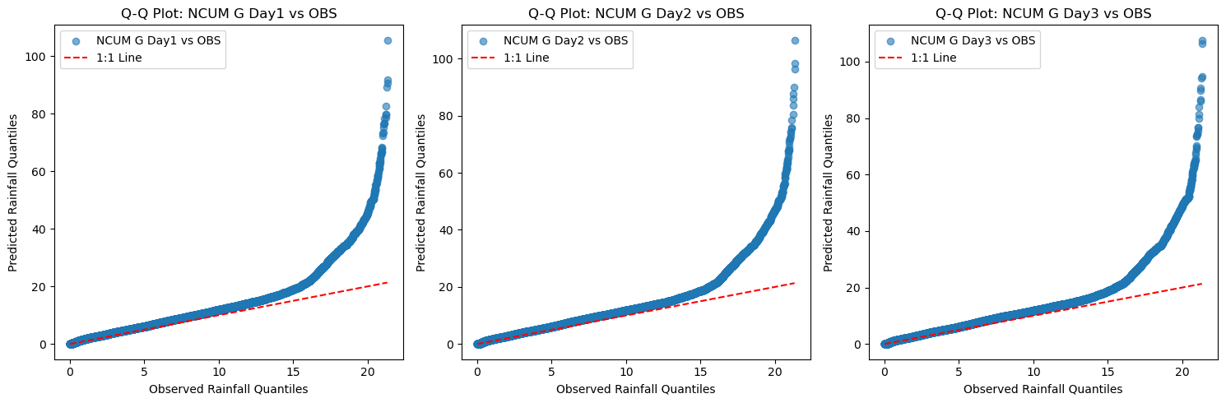
QQ plot - Rainfall
NCUM-G

Slide 22
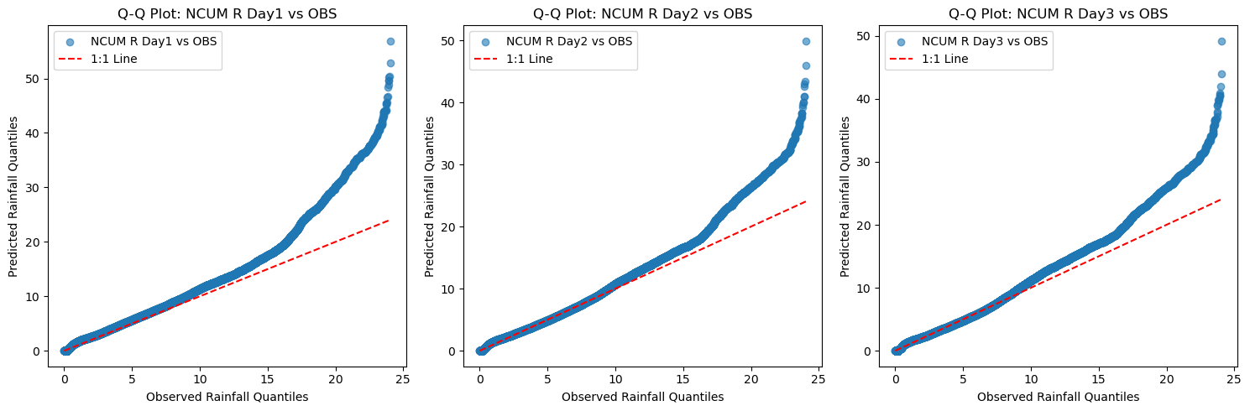
QQ plot - Rainfall
NCUM-R
Notes:
NCUM G
NCUM R
Curve follows 1:1 line at lower quantiles, and diverges sharply.
Curve follows 1:1 line at lower quantiles, and diverges but not as sharp as NCUM-G.
Largely overestimates large values.
Overestimates large values.
Reasonably accurate at lower rainfall & bias increase sharply at high quantiles.
Reasonably accurate at lower rainfall & bias increase with high quantiles.
Very high tendency to over-predict extremes.
Tendency to over-predict extremes.

Slide 23
QQ plot - Rainfall
Feature | NCUM G | NCUM R
General Fit | Curve follows 1:1 line at lower quantiles, and diverges sharply. | Curve follows 1:1 line at lower quantiles, and diverges but not as sharp as NCUM-G.
High Quantile Behaviour | Largely overestimates large values. | Overestimates large values.
Consistency | Reasonably accurate at lower rainfall & bias increase sharply at high quantiles. | Reasonably accurate at lower rainfall & bias increase with high quantiles.
Reliability | Very high tendency to over-predict extremes. | Tendency to over-predict extremes.

Slide 24
Frequency of Rainfall
Moderate Rainfall
Heavy Rainfall
≥ 15.6 mm/day
≥ 64.5 mm/day

Slide 25
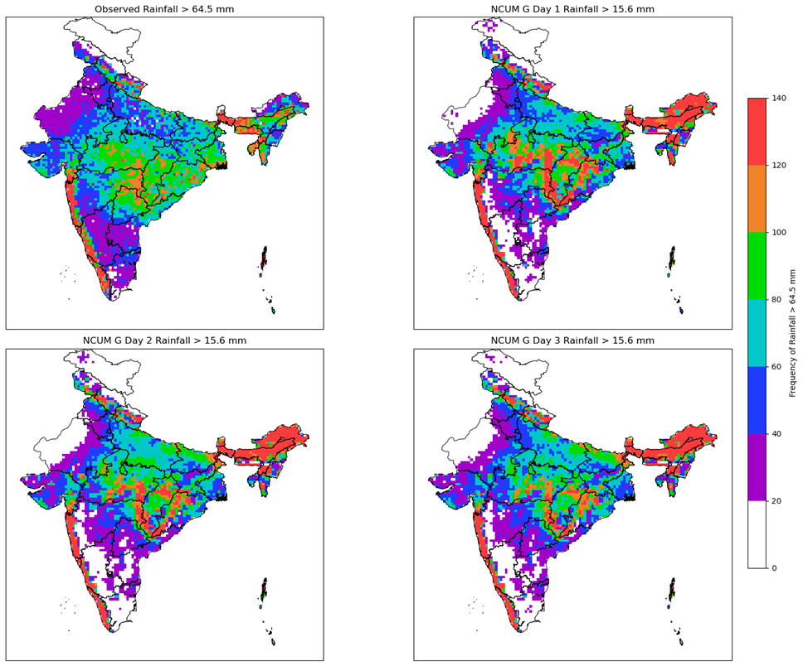
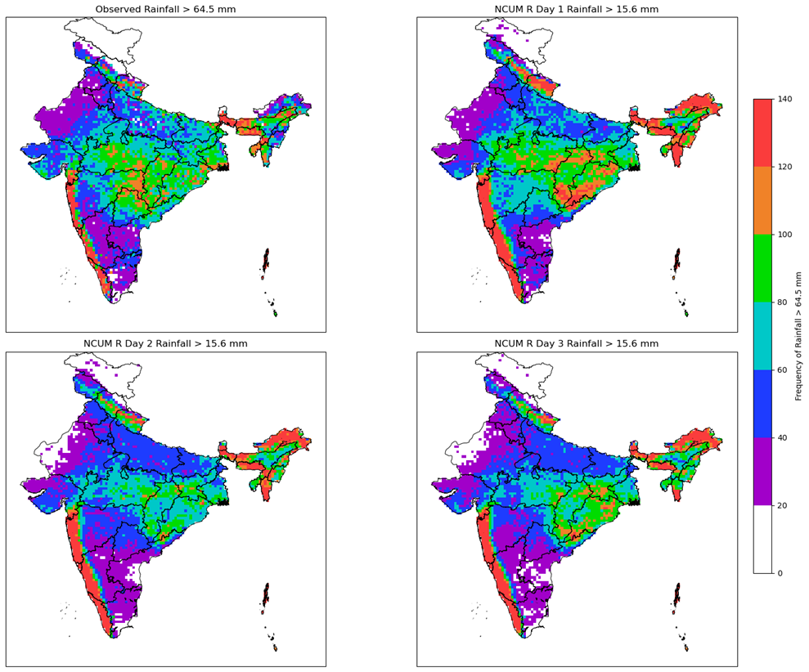

Frequency of Rainfall > 15.6mm
NCUM-G
NCUM-R

Slide 26
Frequency of Rainfall Moderate
Region | Observation | NCUM-G
NE India | High frequency (Assam, etc.) | Captures well, little high
Western Coast | Very high frequency (Kerala, Goa, etc.) | Captures well, exaggerate little
Central India | Moderate (MP, Odisha, etc.) | Underestimated significantly
North/NW India | Very low frequency (Punjab etc) | Overpredicts rainfall (false alarms)
≥ 15.6 mm/day
Notes:
TensorFlow/Keras - a popular DL framework

Slide 27
Frequency of Rainfall Moderate
Region | Observation | NCUM-R
NE India | High frequency (Assam, etc.) | Really good intensity and spread
Western Coast | Very high frequency (Kerala, Goa, etc.) | Captures well, exaggerate little
Central India | Moderate (MP, Odisha, etc.) | Underestimated significantly
North/NW India | Very low frequency (Punjab etc) | Overpredicts rainfall (false alarms)
≥ 15.6 mm/day
Notes:
TensorFlow/Keras - a popular DL framework

Slide 28
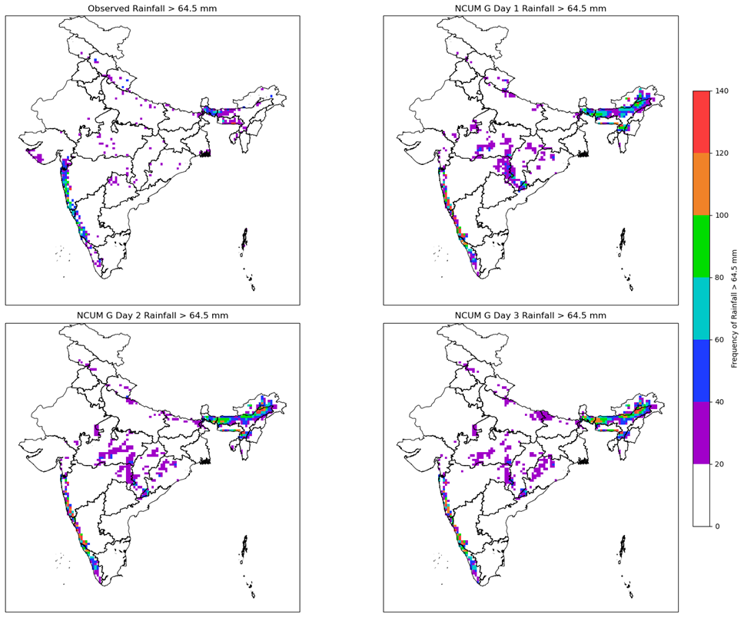
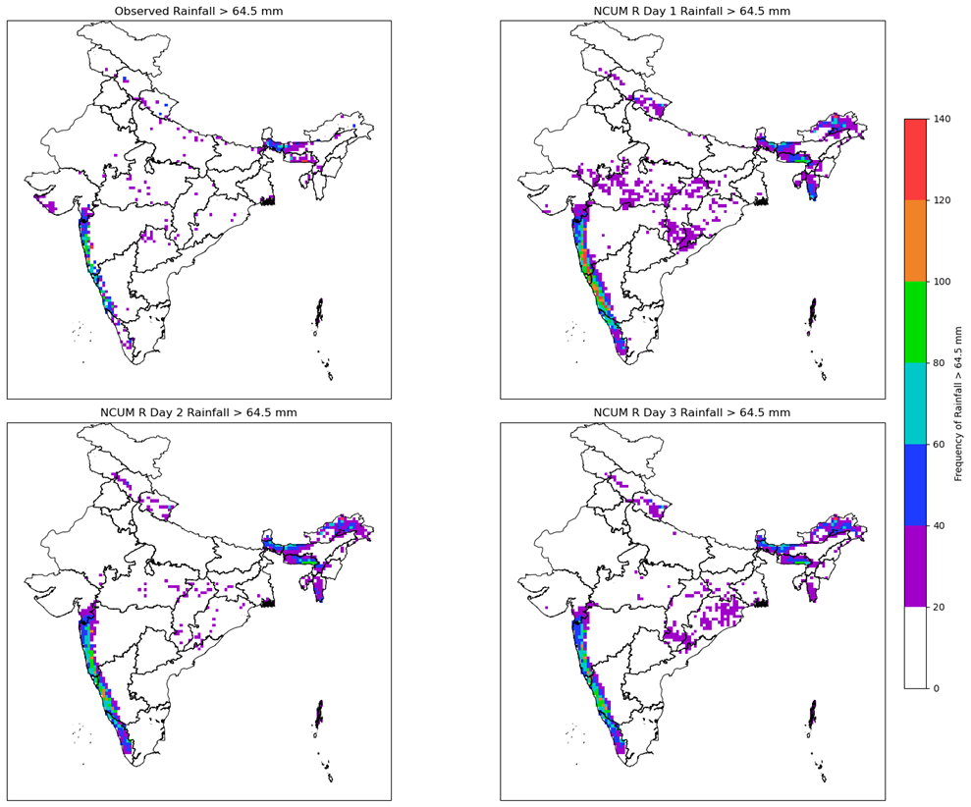
Frequency of Rainfall > 64.5mm
NCUM-G
NCUM-R

Slide 29
Frequency of Rainfall Heavy
Region | Observation | NCUM-G
NE India | High frequency (Assam, etc.) | Captures well, little high
Western Coast | Very high frequency (Kerala, Goa, etc.) | Captures well, exaggerate little
Central India | Moderate (MP, Odisha, etc.) | Underestimated significantly
North/NW India | Very low frequency (Punjab etc) | Overpredicts rainfall (false alarms)
≥ 64.5 mm/day
Notes:
TensorFlow/Keras - a popular DL framework

Slide 30
Frequency of Rainfall Heavy
Region | Observation | NCUM-R
NE India | High frequency (Assam, etc.) | Captures well (good intensity and spread)
Western Coast | Very high frequency (Kerala, Goa, etc.) | Realistic intensity and distribution
Central India | Moderate (MP, Odisha, etc.) | underestimates better than ncumG
North/NW India | Very low frequency (Punjab etc) | Less overprediction; (better @ dry)
≥ 64.5 mm/day
Notes:
TensorFlow/Keras - a popular DL framework

Slide 31
03
Statistical Bias Corrections
EQM ? PQM ?? GPQM??

Slide 32
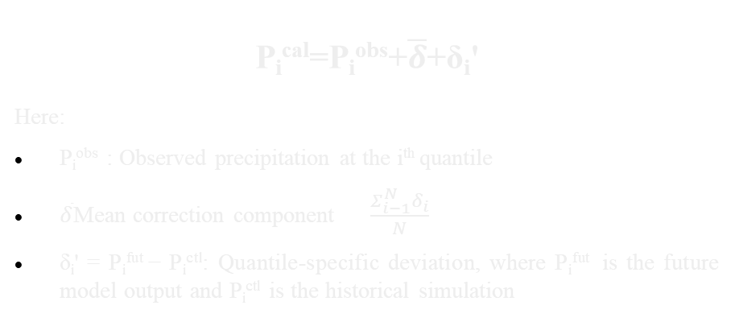
Empirical Quantile Mapping
Non-parametric bias correction method
Match => quantile-by-quantile
Correction derived up to the 99th percentile
EQM
P_{i}^{cal}=P_{i}^{obs}+$\overline{δ}$+δ_{i}'
Here:
P_{i}^{obs} ​: Observed precipitation at the i^{th} quantile
$\overline{δ}$Mean correction component $\frac{Σ_{ⅈ−1}^{N}δ_{i}}{N}$
δ_{i}' = P_{i}^{fut} − P_{i}^{ctl}: Quantile-specific deviation, where P_{i}^{fut} ​ is the future model output and P_{i}^{ctl}​ is the historical simulation
Notes:
Obs says 70th percentile = 15 mm → Correction = +5 mm → So, model's 10 mm gets corrected to 15 mm
After 99th
99th percentile correction was +10 mm, then:
Model’s 110 mm → corrected to 120 mm
Model’s 130 mm → corrected to 140 mm

Slide 33
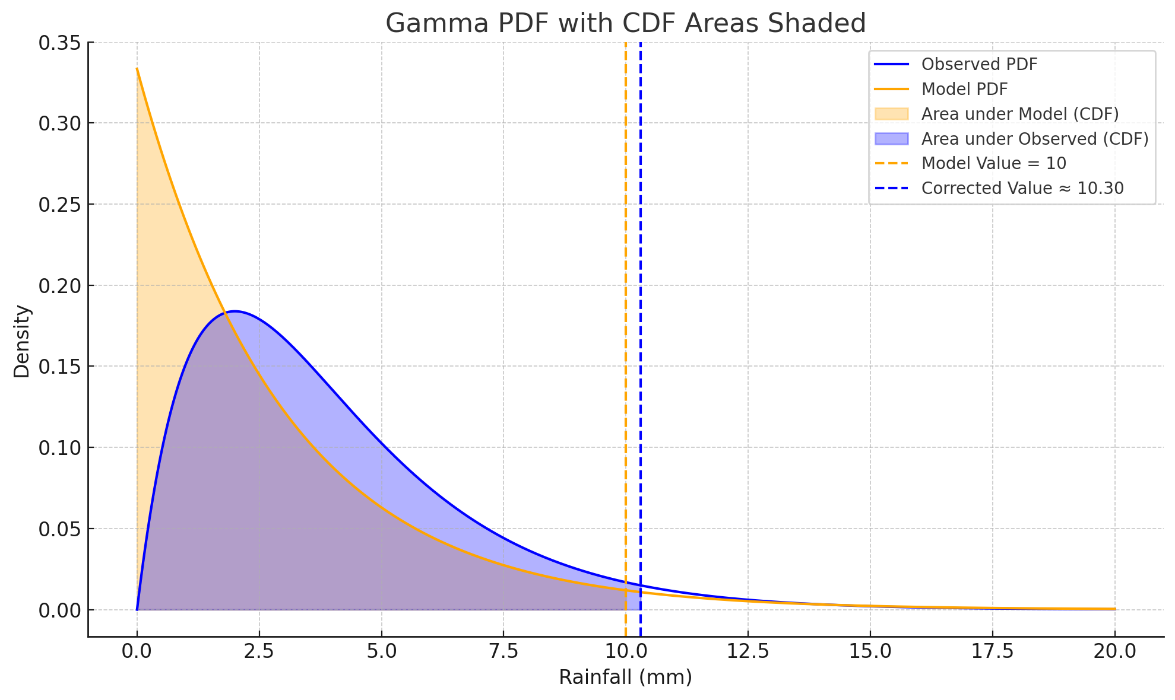

Parametric Quantile Mapping
Model and Observed data follows a gamma distribution
probability of value in models gamma curve => probability on observation’s curve
PQM
K – Shape parameter
σ – Scale parameter
$$y=f\left(\left.x\right|k,σ\right)=\frac{1}{σ^{k}Γ_{\left(k\right)}}x^{k−1}e^{\frac{−x}{σ}}$$
If k < 1 → the gamma curve blows up at 0 mm (adjust dry days i.e, set a threshold for “dry”)
Weak against extremes (PQM doesn’t limit extremes — leading to false alarms)
Notes:
Replace zeros with a small threshold, like 0.1 mm
k = (mean²) / variance
σ = variance / mean
Γ(n)=(n−1)! == [$Γ\left(k\right)=\int_{0}^{∞}{t^{k−1}ⅇ^{−t}ⅆt}$] == gamma function
PDF → Tells how likely different x are
CDF → Area under PDF → used in PQM mapping
That’s why some studies use a mix of Gamma + Generalized Pareto Distribution (GPD) — to better handle extreme rainfall.

Slide 34
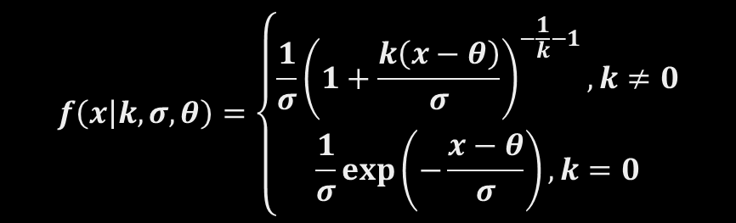
Gamma + Generalized Pareto Quantile Mapping
Hybrid method
Fit Gamma - below 95th percentile
Fit GPD - above 95th percentile
GPQM
“Match percentiles fitted distributions” and “Dry day adjustment” is same as in PQM
$$f\left(\left.x\right|k,σ,θ\right)=\left\{\begin{matrix}\frac{1}{σ}{\left(1+\frac{k\left(x−θ\right)}{σ}\right)}^{−\frac{1}{k}−1},k≠0 \\ \frac{1}{σ}\exp\left(−\frac{x−θ}{σ}\right),k=0\end{matrix}\right.$$
Notes:
Gamma distribution to the 95th percentile
Generalized Pareto distribution above 95th percentile
Gamma part: shape (a), scale (b)
GPD part: shape (k), scale (σ), threshold (θ)
Let μ = mean of exceedances
Let s² = variance of exceedances
Use the moment estimator formulas:
$k=\frac{1}{2}\left(1−\frac{μ^{2}}{s^{2}}\right)$ -> shape
$σ=\frac{1}{2}μ\left(1+\frac{μ^{2}}{s^{2}}\right)$ -> scale
θ = threshold (95th percentile)
Especially good for:
Bias-correcting extreme rainfall
Forecast verification

Slide 35
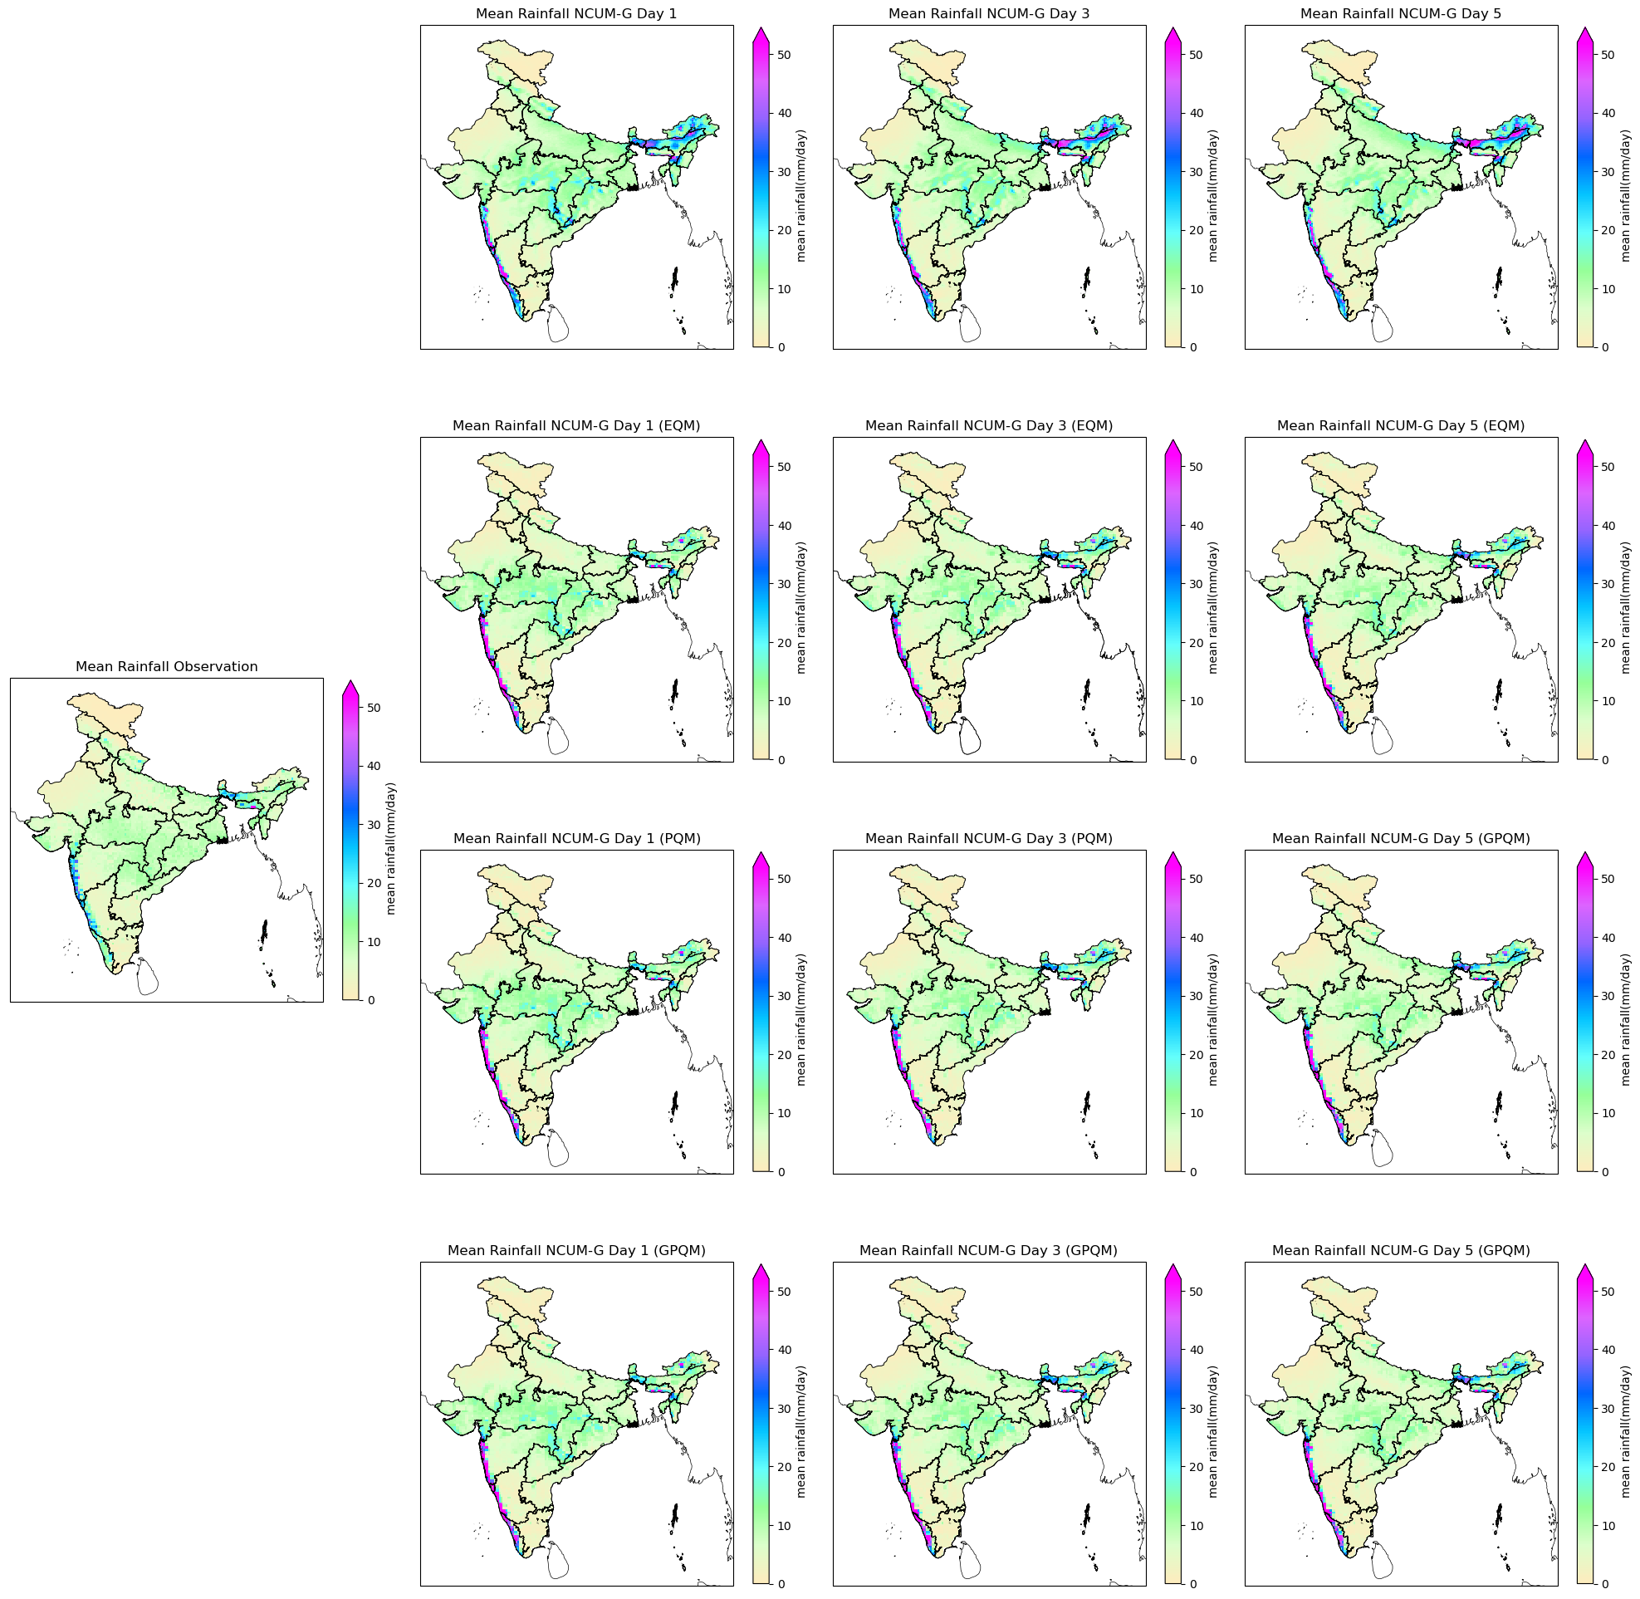
Mean Rainfall
Whole India
Notes:
NCUM-G overestimates heavy rainfall:
Over the Western Ghats, Northeast India, and Odisha.
Worsens in Day 3 & 5 forecasts.
Bias correction methods improve forecasts:
EQM improves general rainfall amounts, but not extremes.
PQM better captures higher rainfall intensities.
GPQM gives the most realistic rainfall distribution and extremes.
GPQM is the best-performing correction:
Accurate intensity and distribution
Reduces overestimation of heavy rainfall in high-rainfall regions

Slide 36
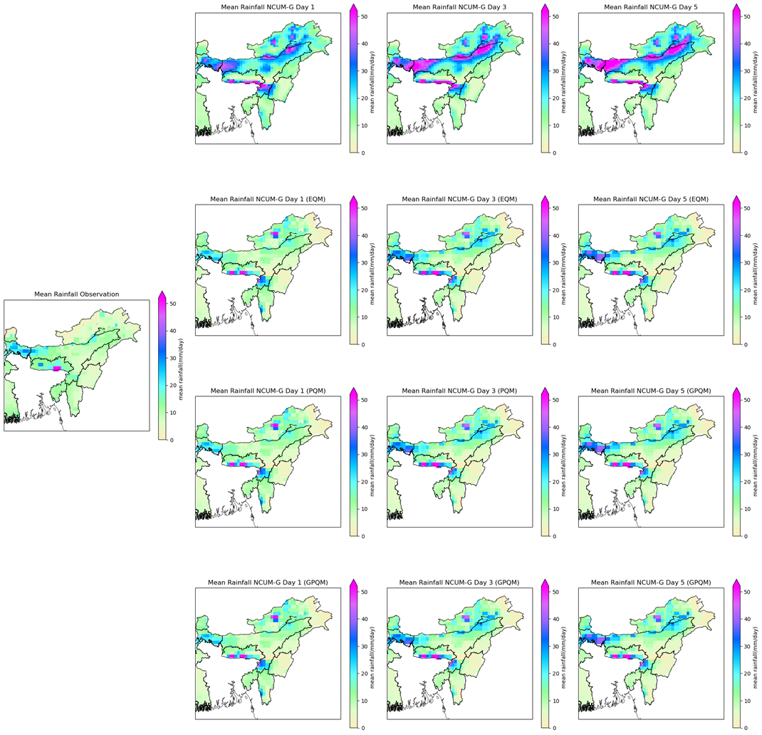
Mean Rainfall
NE
India
Notes:
Raw NCUM-G Forecast:
Overestimates heavy rainfall regions.
Forecast has excessive rain in localized areas. (high bias)
Bias increases over time
EQM:
Reduces excessive rainfall bias but still retains some overprediction.
Day 5 forecast still deviates from observed patterns.
PQM:
Further improves spatial distribution, reducing overestimated rain bands
Shows better alignment with observation (Day 1 and Day 3)
GPQM: (Best)
Matches observed rainfall pattern closely, even at longer lead times
Significantly smooths overestimated rainfall hotspots

Slide 37
Mean Rainfall
NCUM-G overestimates heavy rainfall:
Over the Western Ghats, Northeast India, and Odisha.
Worsens in Day 3 & 5 forecasts.
Bias correction methods improve forecasts:
EQM improves general rainfall amounts, but not extremes.
PQM better captures higher rainfall intensities.
GPQM gives the most realistic rainfall distribution and extremes.
GPQM is the best-performing correction:
Accurate intensity and distribution
Reduces overestimation of heavy rainfall in high-rainfall regions.

Slide 38
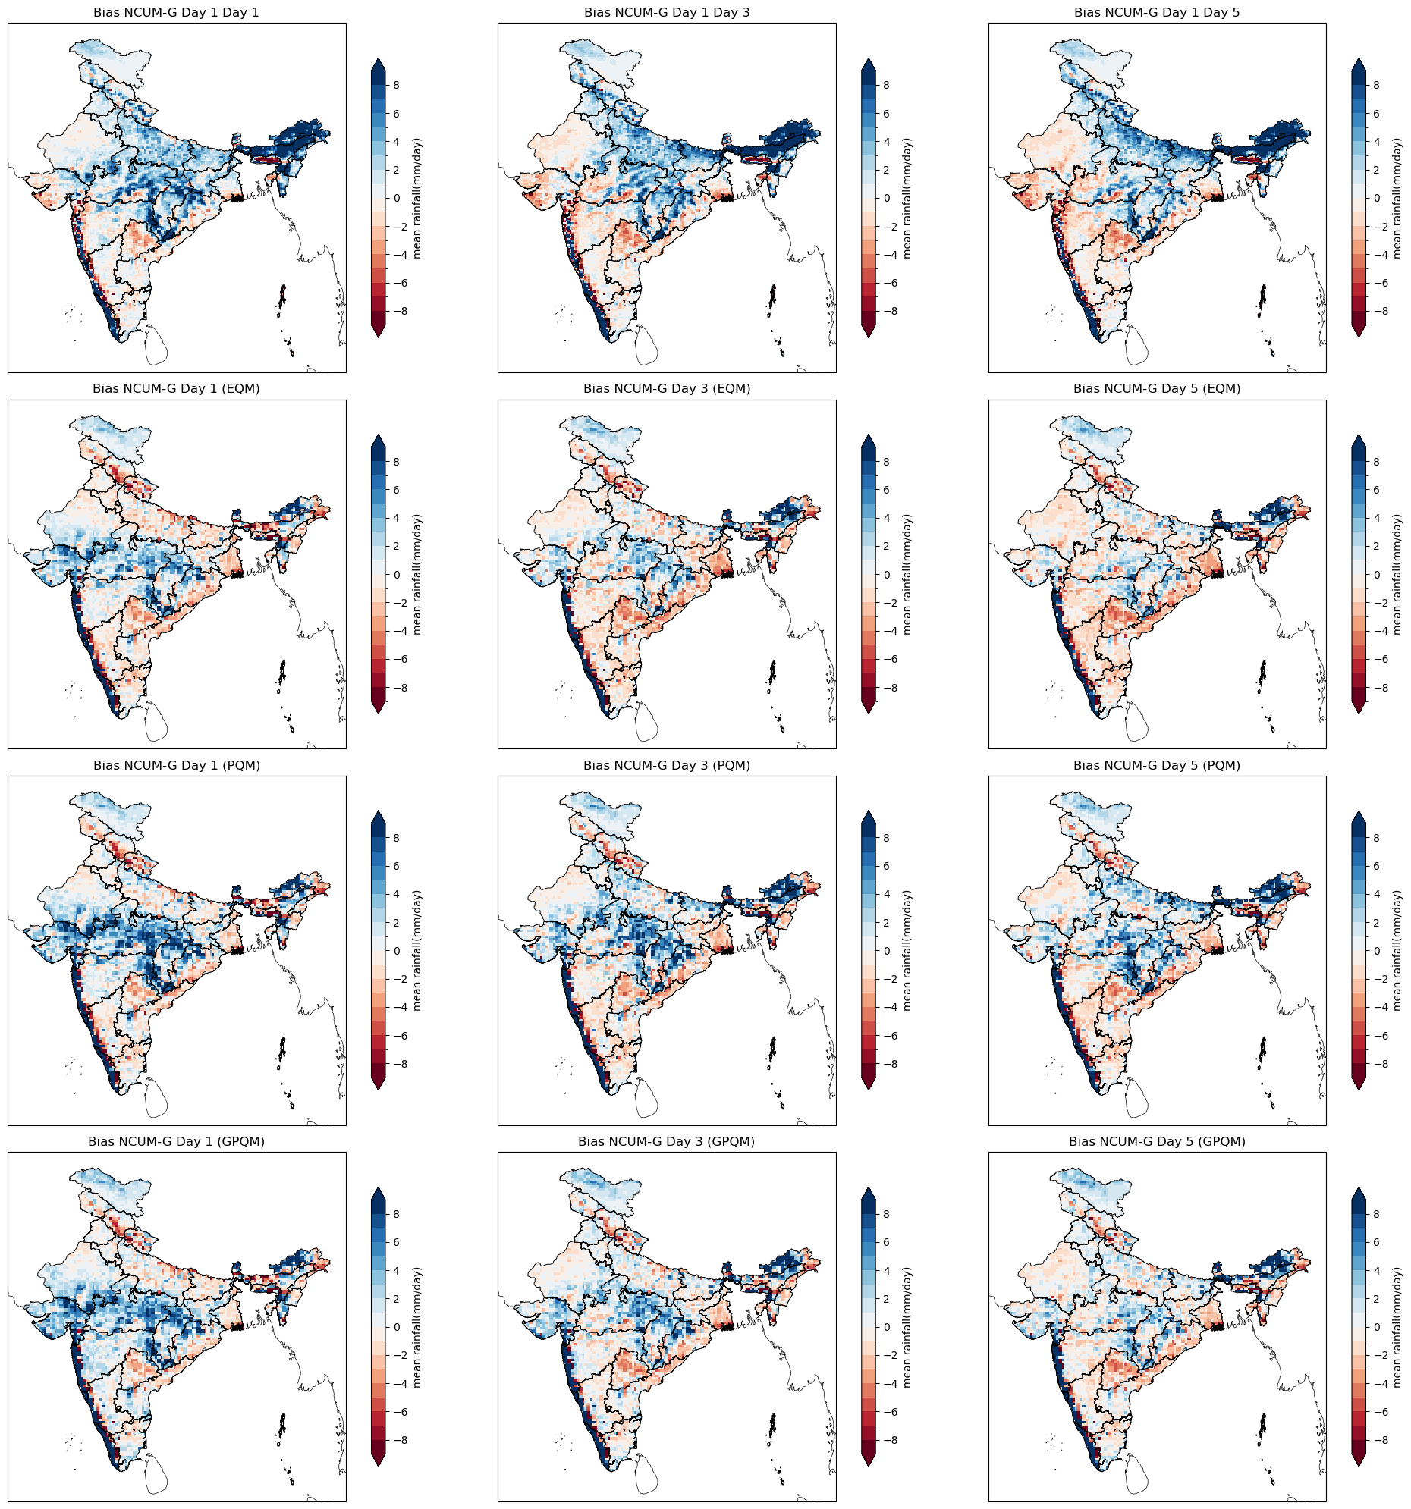
Spatial Bias of Rainfall
Whole India

Slide 39
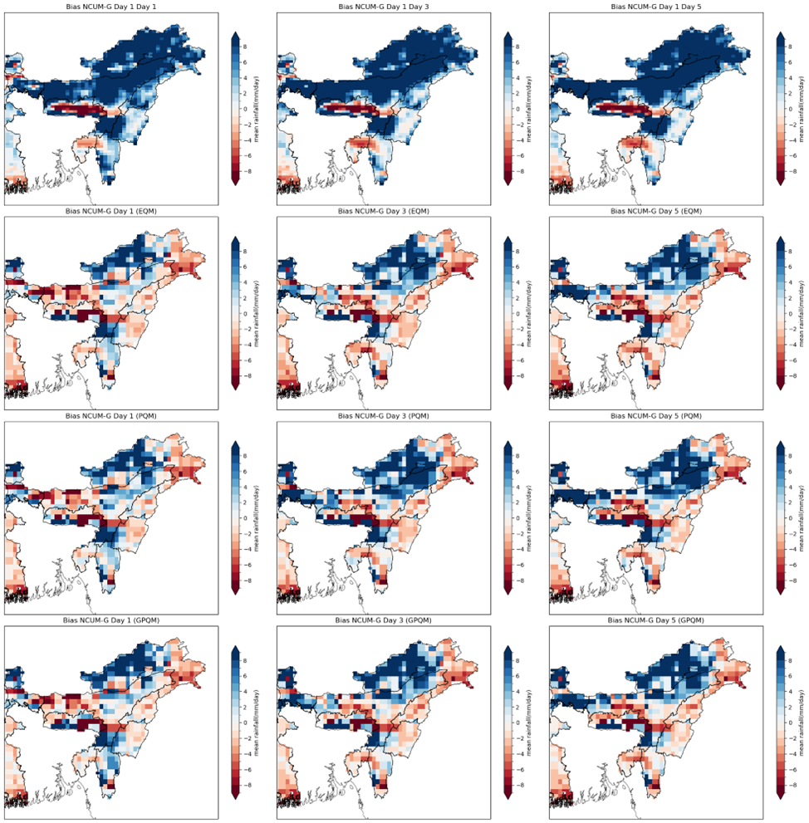
Spatial Bias of Rainfall
NE
India

Slide 40
Spatial Bias of Rainfall
Region | EQM Fixes | PQM Fixes | GPQM Fixes
Western Ghats | Slight improvement | Some correction | Best correction
Northeast India | Good improvement | Better than EQM | Best correction
Central India | Minor fix | Better fix | Best fix
Eastern Coast | Partial fix | Good fix | Best correction
Himalayan Foothills | Some fix | Good fix | Best correction

Slide 41
Forecast Verification
Method | BIAS | POD (Detecting Rain) | FAR (False Alarms) | ETS (Forecast Skill) | Conclusions
Raw NCUM-G | Overpredicts (~1.4-1.5) | High (~0.75-0.8) | High (~0.4) | Poor (~0.2) | Too many false alarms, poor skill
EQM | Reduces (~0.8-0.9) | Moderate (~0.5) | Slightly higher (~0.4-0.45) | Slight improvement (~0.3) | Balanced but still false alarms
PQM | Reduces (~0.9) | Slightly lower (~0.45) | Similar (~0.4-0.45) | Slight improvement (~0.3) | No real improvement in skill, but slightly better POD
GPQM (Best) | Best (~0.8) | Lower (~0.4-0.45) | Slightly reduced (~0.4-0.42) | Small improvement (~0.3) | Best forecast accuracy among all

Slide 42
04
Future Scopes
AI ? ML?? DL ???

Slide 43
Ongoing…
PLAN !
Train ML/DL models to generate high-res rainfall forecasts
Build a DL downscaling model fine tuned for NCUM-G Model in monsoon season
GOAL !
DL-powered downscaling
NEXT UP !
Merge rainfall data with gauge data with RF-techniques’
MERGE !
Notes:
"engine" for the overall model
Convnet : 3x3 kernel
Resnet & Densenet : cross-layer skip connections within each residual block and outer skip connections at the backbone section level
Densenet : all layers are connected to every other layers
Convnext : 7x7 kernel like Vision Transformers , resnet but better,

Slide 44
05
References & Acknowledgements’

Slide 45
REFERENCES
Ashrit, Raghavendra, A. K. Mitra, G. R. Iyengar, Sushant Kumar, Arun Kumar, S. K. Dutta, V. R. Durai, John P. George, and E. N. Rajagopal. 2020. “IMDAA: High-Resolution Satellite-Era Reanalysis for the Indian Monsoon Region.” Journal of Earth System Science 129 (1): 68–68. https://doi.org/10.1007/s12040-019-1306-3.
Atkinson, Peter M. 2013. “Downscaling in Remote Sensing.” Spatial Statistics for Mapping the Environment 22 (June):106–14. https://doi.org/10.1016/j.jag.2012.04.012.
Ehret, U., E. Zehe, V. Wulfmeyer, K. Warrach-Sagi, and J. Liebert. 2012. “HESS Opinions ‘Should We Apply Bias Correction to Global and Regional Climate Model Data?’” Hydrology and Earth System Sciences 16 (9): 3391–3404. https://doi.org/10.5194/hess-16-3391-2012.
Hertig, Elke, Douglas Maraun, Judit Bartholy, Rita Pongracz, Mathieu Vrac, Ileana Mares, José M. Gutiérrez, Joanna Wibig, Ana Casanueva, and Pedro M. M. Soares. 2019. “Comparison of Statistical Downscaling Methods with Respect to Extreme Events over Europe: Validation Results from the Perfect Predictor Experiment of the COST Action VALUE.” International Journal of Climatology 39 (9): 3846–67. https://doi.org/10.1002/joc.5469.
Kumar, K. Niranjan, Sukhwinder Kaur, Mohana S. Thota, M. Venkatarami Reddy, Harvir Singh, Sushant Kumar, Anumeha Dube, and Raghavendra Ashrit. 2024. “NCUM Global Model Verification: Pre-Monsoon (MAM) 2024.” Noida, India: National Centre for Medium-Range Weather Forecasting (NCMRWF). https://www.ncmrwf.gov.in/Reports-eng/NCUMG_MAM2024.pdf.

Slide 46
REFERENCES
Rani, S. Indira, T. Arulalan, John P. George, E. N. Rajagopal, Richard Renshaw, Amanda Maycock, and M. Rajeevan. 2021. “Evaluation of IMDAA High-Resolution Reanalysis Rainfall Products over India During Monsoon Seasons.” Journal of Geophysical Research: Atmospheres 126 (5). https://doi.org/10.1029/2020JD033454.
Suarez-Gutierrez, Laura, Sebastian Milinski, and Nicola Maher. 2021. “Exploiting Large Ensembles for a Better yet Simpler Climate Model Evaluation.” Climate Dynamics 57 (9): 2557–80. https://doi.org/10.1007/s00382-021-05821-w.
Velasquez, Patricio, Marco Messmer, and Christoph C. Raible. 2019. “A New Bias-Correction Method for Precipitation over Complex Terrain Suitable for Different Climate States.” Geoscientific Model Development 12 (12): 5337–58. https://doi.org/10.5194/gmd-12-5337-2019.
Hewitson, B. C., and R. G. Crane. 1996. “Climate Downscaling: Techniques and Application.” Climate Research 7 (2): 85–95
Niranjan Kumar, Kondapalli, Mohana Satyanarayana Thota, Raghavendra Ashrit, Ashis K. Mitra, and Madhavan Nair Rajeevan. 2022. “Quantile Mapping Bias Correction Methods to IMDAA Reanalysis for Calibrating NCMRWF Unified Model Operational Forecasts.”
Rummukainen, Markku. 2010. “State-of-the-Art with Regional Climate Models.” WIREs Climate Change 1 (1): 82–96. https://doi.org/10.1002/wcc.8.
.

Slide 47
REFERENCES
WANG, Yuqing, L. Ruby LEUNG, John L. McGREGOR, Dong-Kyou LEE, Wei-Chyung WANG, Yihui DING, and Fujio KIMURA. 2004. “Regional Climate Modeling: Progress, Challenges, and Prospects.” Journal of the Meteorological Society of Japan. Ser. II 82 (6): 1599–1628. https://doi.org/10.2151/jmsj.82.1599

Slide 48
THANK YOU !

